Slide 1
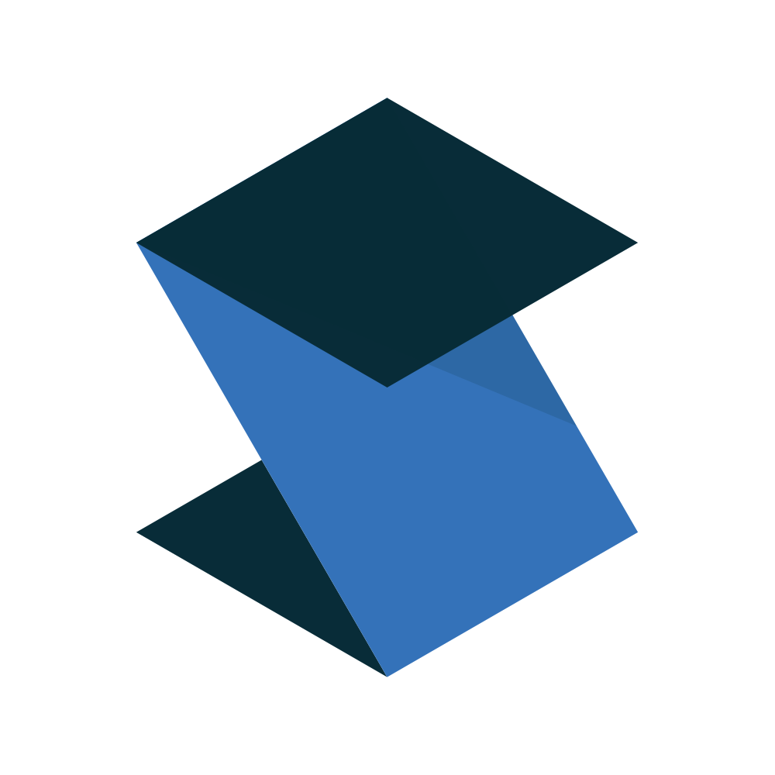

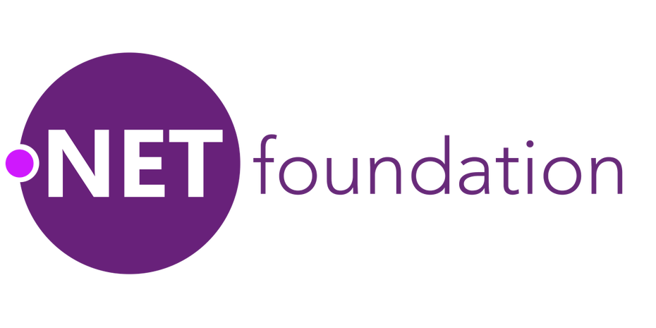

Capabilities
a toolkit for building cloud-native .NET microservices

Slide 2
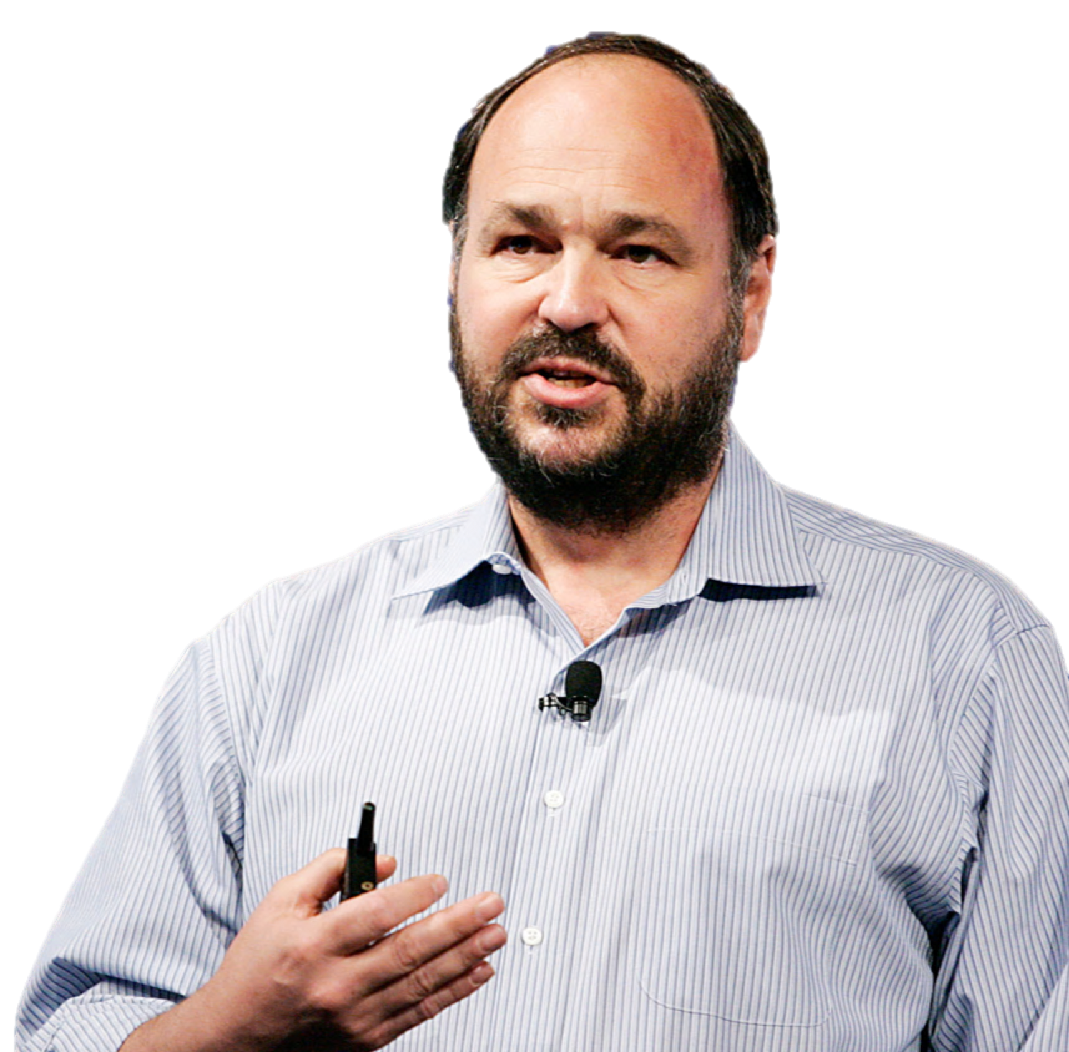
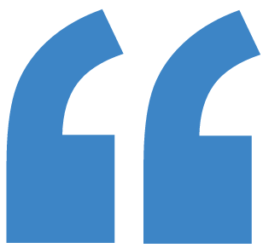
the Cloud isn’t about
where
computing is done,
rather
how it’s done.
– Paul Maritz
Notes:
SLOW Quote by one of Pivotal’s founders, current Chairman and former CEO.
At it’s most fundamental part. Cloud computing is really a concept of where computing is done. We’ve shifted computing often times from our own datacenter into a third party data center.
But there’s more. To really unlock the power of cloud you have to think beyond where the computation happens and think about how it happens.
We’re able to quickly provision resources on demand.
We can easily disperse are workloads geographically across the world.
The ability to scale is for most intents and purposes limitless.

Slide 3
But how? → Cloud-Native
The cloud encourages new design principles
12 Factors (Heroku)
Cloud-Native principles
enabling you to
do new things
Notes:
SLOW
So now that we have this new paradigm on computing. How do we take advantage of it? We’ve discussed several ways
We’ve talked about being cloud native.
We’ve talked about the 12 factor app.
We’ve talked about some of the outcomes when you apply these principles.
Connecting with customers in new ways.
Allowing you to build new things
Allowing you to innovate faster.
Differentiating you from competitors

Slide 4
Microservices
Microservice architectures have many benefits
Quickly iterate and release frequently
Easy for new devs to join and be productive
Increased developer velocity
Shorter test cycles
Polyglot becomes reality
Independently scalable components
Notes:
SLOW
We’ve talked quite a bit today about microservices and you’ve probably read quite a bit about them over the years.
By decoupling pieces of applications and enforcing explicit boundaries, these are just some of the benefits we see:
Quick iteration and more frequent releases
Easy for new devs to join and be productive
Increased velocity
Shorter test cycles
Ployglot is reality. Using the right tool for the job
And we see the ability to independently scale.

Slide 5
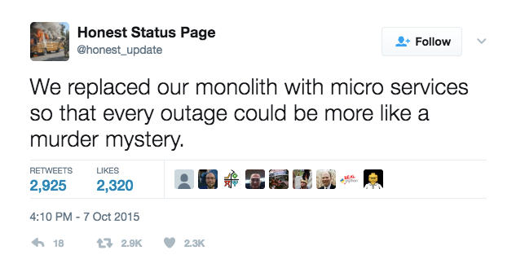
But Microservices are hard
Microservices = Distributed Systems = Way more complexity
How to troubleshoot microservices?
How to set global configuration across the whole application?
How to look up the dynamic addresses of services you consume?
What do you do when a service you depend on stops responding?
Notes:
SLOW
With all of these benefit we see there’s a looming reality. Microservices are HARD!
Moving to a distributed system introduces complexity!
But microservice architectures are distributed systems. And distributed systems have way more complexity than a monolith.

Slide 6
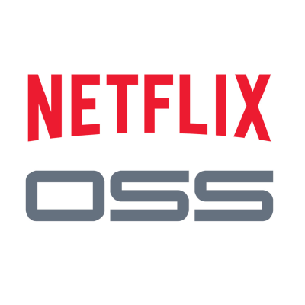

The good news is...
There are some great OSS solutions to these problems available from
and
But until now they’ve been focused on Java and not very accessible to .NET devs…
Notes:
SLOW
There is good news!
We’ve all heard the stories of Netflix.
40% of internet traffic.
Massive scale.
They have been really big in the open source community and have popularized several patterns..
If you guys have your ears open to the Java world there’s a framework called Spring that is the best framework for composing microservices in Java.
They’ve taken these open source implementations and made them available to the large spring community.
That’s great! But what about us .NET developers!?!?

Slide 7
So that’s why we built Steeltoe
To help you build
Cloud native .NET applications (for Cloud Foundry)
that can leverage Spring Cloud tooling for
resilient microservices
Notes:
SLOW
Enable .NET developers to build Cloud-Native apps
Enable us to leverage Spring Cloud and Spring Cloud Services tooling for resilient microservices.

Slide 8
What’s inside the box?

Slide 9
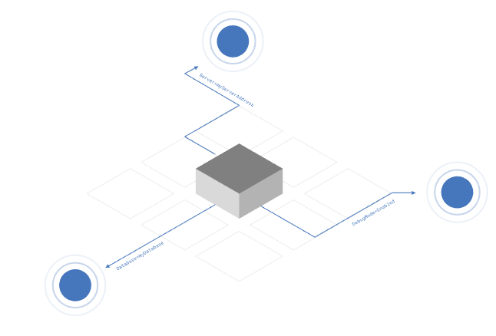
Configuration Providers
Cloud Foundry
VCAP_APPLICATION, VCAP_SERVICES, CF_*
Config Server
Access config stored in Spring Cloud Config Server (backed by Git, Vault, local filesystem)
Across all instances, all apps, all environments
Notes:
SLOW
We build on the Configuration API provided by .NET which enables you to pull values from different sources using Configuration Providers.
Each provider supports reading a set of name-value pairs from a different source location; adding them into a combined multi-level configuration dictionary.
Out of the box, .NET supports getting configuration from:
Command-line arguments
File sources (e.g. JSON, XML and INI)
Environment variables
Custom providers
Steeltoe adds two additional providers to that list:
Cloud Foundry Provider
This provider enables the standard Cloud Foundry environment variables, VCAP_APPLICATION, VCAP_SERVICES and CF_* to be parsed and accessed as configuration data.
Config Server Provider
This provider enables the Spring Cloud Config Server to be used as a source of configuration data for a .NET application.
Steeltoe’s configuration supports both reading the config values directly, as well as Dependency Injection with the Options framework

Slide 10
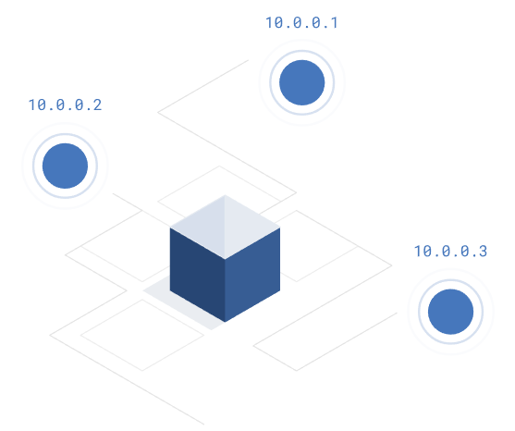
Service Discovery
Service Discovery Client
.NET client for Netflix Eureka
Implements Service Discovery design pattern
Dynamically discover and call registered services
Notes:
SLOW
As services scale in and out, you need a way to look up instance addresses.
Trying to hand-configure each client of a service or adopt some form of access convention can be difficult and prove to be brittle in production. Instead, applications can use a service registry to dynamically discover and call registered services.
There are several options to choose from when implementing the Service Discovery pattern. Steeltoe has initially chosen to support one based on Eureka; using Netflix’s Service Discovery server and client.

Slide 11

Circuit Breaker
Circuit Breaker Client
.NET implementation of Netflix Hystrix
Bypass failing services with elegant fall-back behavior (so your users don’t see nasty error messages)
Rich metrics and monitoring

Slide 12
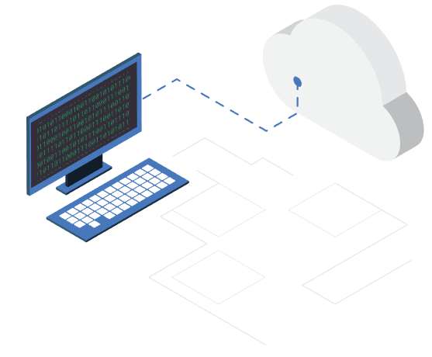
Cloud Connectors
Connectors for common data services
MySQL
Postgres
MS-SQL
Redis
RabbitMQ
OAuth (for UAA or Pivotal Single Sign-on)
Notes:
SLOW
Steeltoe Connectors simplify the process of connecting to and using backing data services on Cloud Foundry.
They provide out-of-the-box support for discovering many common services on Cloud Foundry.
They also include the ability to use settings-based configuration so developers can supply configuration settings at development and testing time, but then have those settings overridden when pushing the application to Cloud Foundry.

Slide 13

Management Endpoints (Actuators)
/info arbitrary app info, e.g. git build tag
/health application health information
/trace circular buffer of last 100 http requests/responses
/loggers shows and modifies configuration of loggers down to the class level
Notes:
SLOW
Steeltoe helps you manage and troubleshoot your application by exposing standard (from Spring Boot) management endpoints (aka Spring Boot Actuators)
In Steeltoe 1.1 we will include these 4 endpoints that will automatically get bound to your application

Slide 14
Open Source and Flexible
Steeltoe works...
with .NET Core and with the .NET framework
on Windows and on Linux
standalone and running on Cloud Foundry
...and it’s now part of the
Notes:
SLOW
.NET Foundation announced in November 2017

Slide 15
Availability & New Features

Slide 16
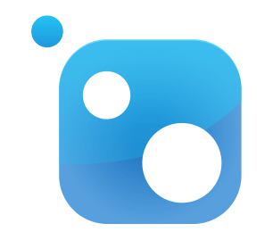
Availability
Packages are available on NuGet.org
2.2.0 (GA) available now!
2.1.0 (GA) released Aug. 20, 2018
2.0.0 (GA) released Feb. 16, 2018
1.0.0 (GA) released Mar. 31, 2017
1.0.0-rc2 released Dec. 2016
1.0.0-rc1 released Oct. 2016
Notes:
SLOW
2.0.0 coming soon

Slide 17
Features
2.2 (Available Now)
New Health Contributors
New Connectors
Service Discovery Load Balancing
2.1
Full ANC 2.1 support
Tracing with Open Census and Zipkin exporter
Metrics Forwarding and Open Census Metrics support
Out-of-the-box Health Contributors for connectors
New Actuators Endpoints - /refresh, /env
Notes:
SLOW
Currently the Eureka client uses a random function to load balance calls to apps. Ribbon would introduce Round-Robin (and other pluggable load balancing algorithms)

Slide 18



How to get started
The best way to get started is to take a look at our docs, clone a sample from the GitHub repo, and contact the team in Slack with questions and feedback.
Learn more → http://steeltoe.io
Check out the samples → https://github.com/steeltoeoss
Get the bits → https://www.nuget.org/profiles/steeltoe
Talk to us → http://slack.steeltoe.io/
Tell your friends → @SteeltoeOSS

